Slide 1
D7032E - Leadership
Based on my experiences
By Josef Hallberg

Slide 2
Upon request during a workshop
Managing a project
Leading a meeting
Leading a workshop
Making time for things

Slide 3

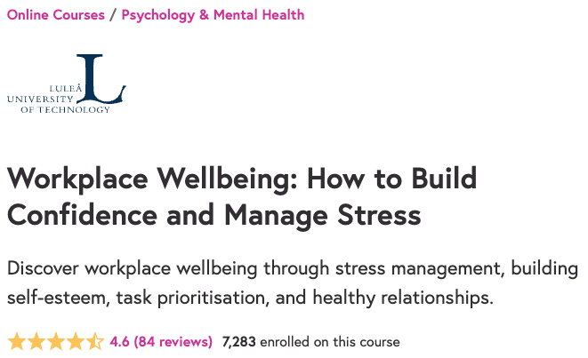
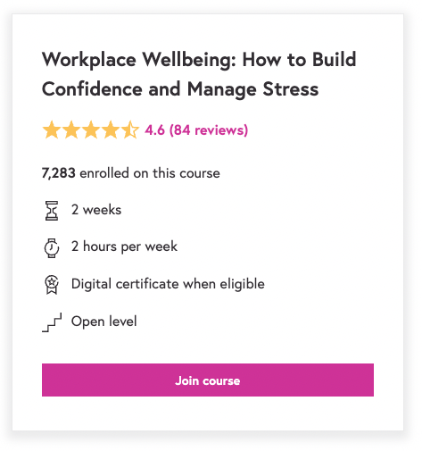
Free course by me
https://www.futurelearn.com/courses/surviving-the-workplace-on-managing-stress-and-building-confidence

Slide 4
”The Project Triangle”
Project constraints:
Time limits
Cost and resource limits
Scope requirements
Scope
Goal
Cost
Time

Slide 5
Summary of what a project is
Obtain goals in an uncertain (and complex) environment,
with the purpose to create value
What are realistic expectations as a project manager?

Slide 6
“From here to there”?

Slide 7
What are we trying to achieve?
Project goals:
Results to be delivered/achieved during the project time period
Effect / Impact
Long term goals
The aim, “why”
In relation to business value
Usually achieved after project closure

Slide 8


Slide 9
The non-expert approach to project management
I report deliverables, so
I am responsible for the quality
I need my project team to deliver
I need to help my team work efficiently
I need to protect their time
I need to build morale

Slide 10
The non-expert approach to project management
Projects usually face difficulties / uncertainties
I need a realistic view of what is achievable
The results we do have are made to fit the goals
… as long as they create value
Know the stakeholders and what they actually want from the project
Because not achieving every goal may not be a failure

Slide 11
There is never enough time
… to follow up
… to catch up on things
… to be knowledgable about things
And this has consequences for those in my team
I might interrupt their work to get updates (so I can make a report)
I might not always express myself in a constructive way
I might not always communicate enough
There are a lot of compromises

Slide 12
Basically… make compromises
What’s the MVP for the project?
What do I prioritise to deliver the MVP?
short term vs. long-term priorities
workplace wellbeing vs. excellent project results
Do the best you can with the time and resources you have
… and hopefully it’ll work out
… and if it doesn’t, then don’t worry too much about it

Slide 13

Leading a meeting

Slide 14
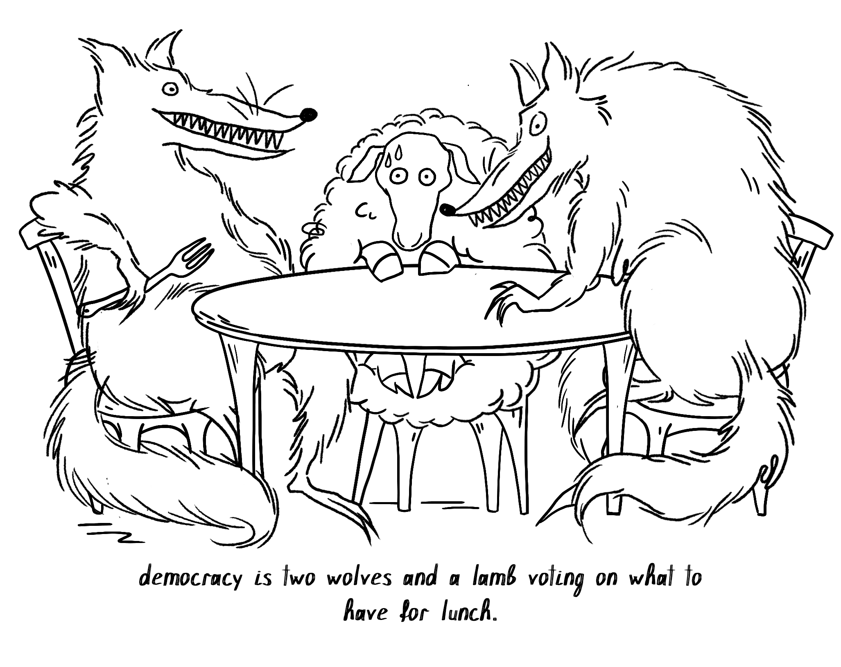
Democracy is overrated…?

Slide 15
The non-expert approach to leading a meeting
Be a benevolent ”dictator” ☺
You have final say
But you are willing to let everyone be heard
You are willing to compromise
The project and team is more important than your pride
Be the leader
Decide when a discussion is done
Make a decision
Make sure everyone has time to be heard
Silence the talkers, give room for the thinkers

Slide 16
The non-expert approach to leading a meeting
Keep the time set for the meeting
Don’t: ”Seems we have some time left, should we also cover…?”
Do: ”We need to cover this…, so let’s plan another meeting for it”
Don’t spend too much time recaping the last meeting
Have a clear agenda in mind
You don’t necessarily need to show all of it to others

Slide 17
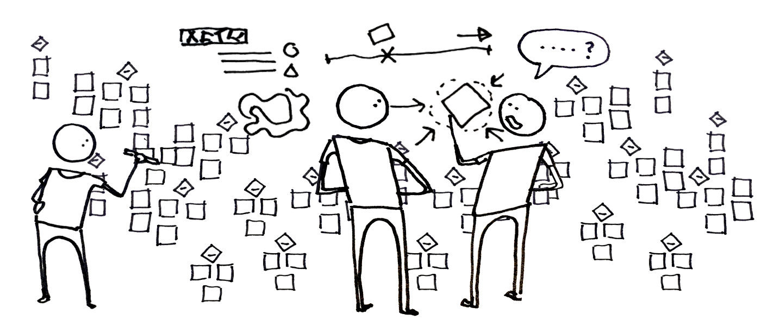
Leading a workshop

Slide 18
The non-expert approach to leading a workshop
Two different agendas
One with topics and rough time estimates to the team
One detailed with time planning down to the minute
(with reserve time for spillover discussions)
What they see
Someone calm giving people sufficient time to discuss things
What you actually do
Look frequently at the time and that spillover time and calculate when and how to cut off the current discussion
Cut off people who like to hear their own voice a lot

Slide 19
The non-expert approach to leading a workshop
Brainstorm on post-its (or similar)
Everyone is heard (or has the opportunity to write something)
You can organise the post-its in categories
Everyones idea is represented somewhere but may be abstracted away without hurting anyones feelings
Make action points and assign someone to be responsible
Otherwise it’s not happening, or you will have to do it

Slide 20

Making time for things

Slide 21
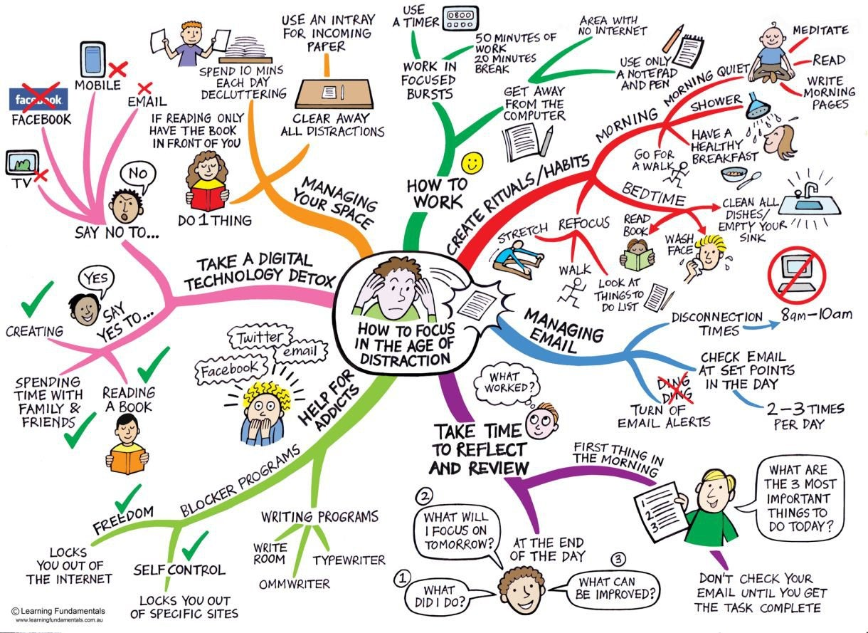

Slide 22
Making time for things
Nobody is too busy, it’s just a matter of priorities.

Slide 23
How to improve work / life balance
Set your sights at what you wish to achieve – work towards goals
Manage your time – How to plan? How much time to devote?
Change your perspective – Perfection or high achievement?
“If you look for perfection, you’ll never be content.” – Leo Tolstoy, Anna Karenina
Focus on the now – live in the moment
Know to say ”No”

Slide 24


Slide 25

How important is work really?

Slide 26
How important is work really?
Money
Meaning
Contribution
Creativity

Slide 27

Enabling life
Family
Home-building
Social activities
Leisure time
Rest

Slide 28


Slide 29

The equation

Slide 30
Work / Life balance

Slide 31
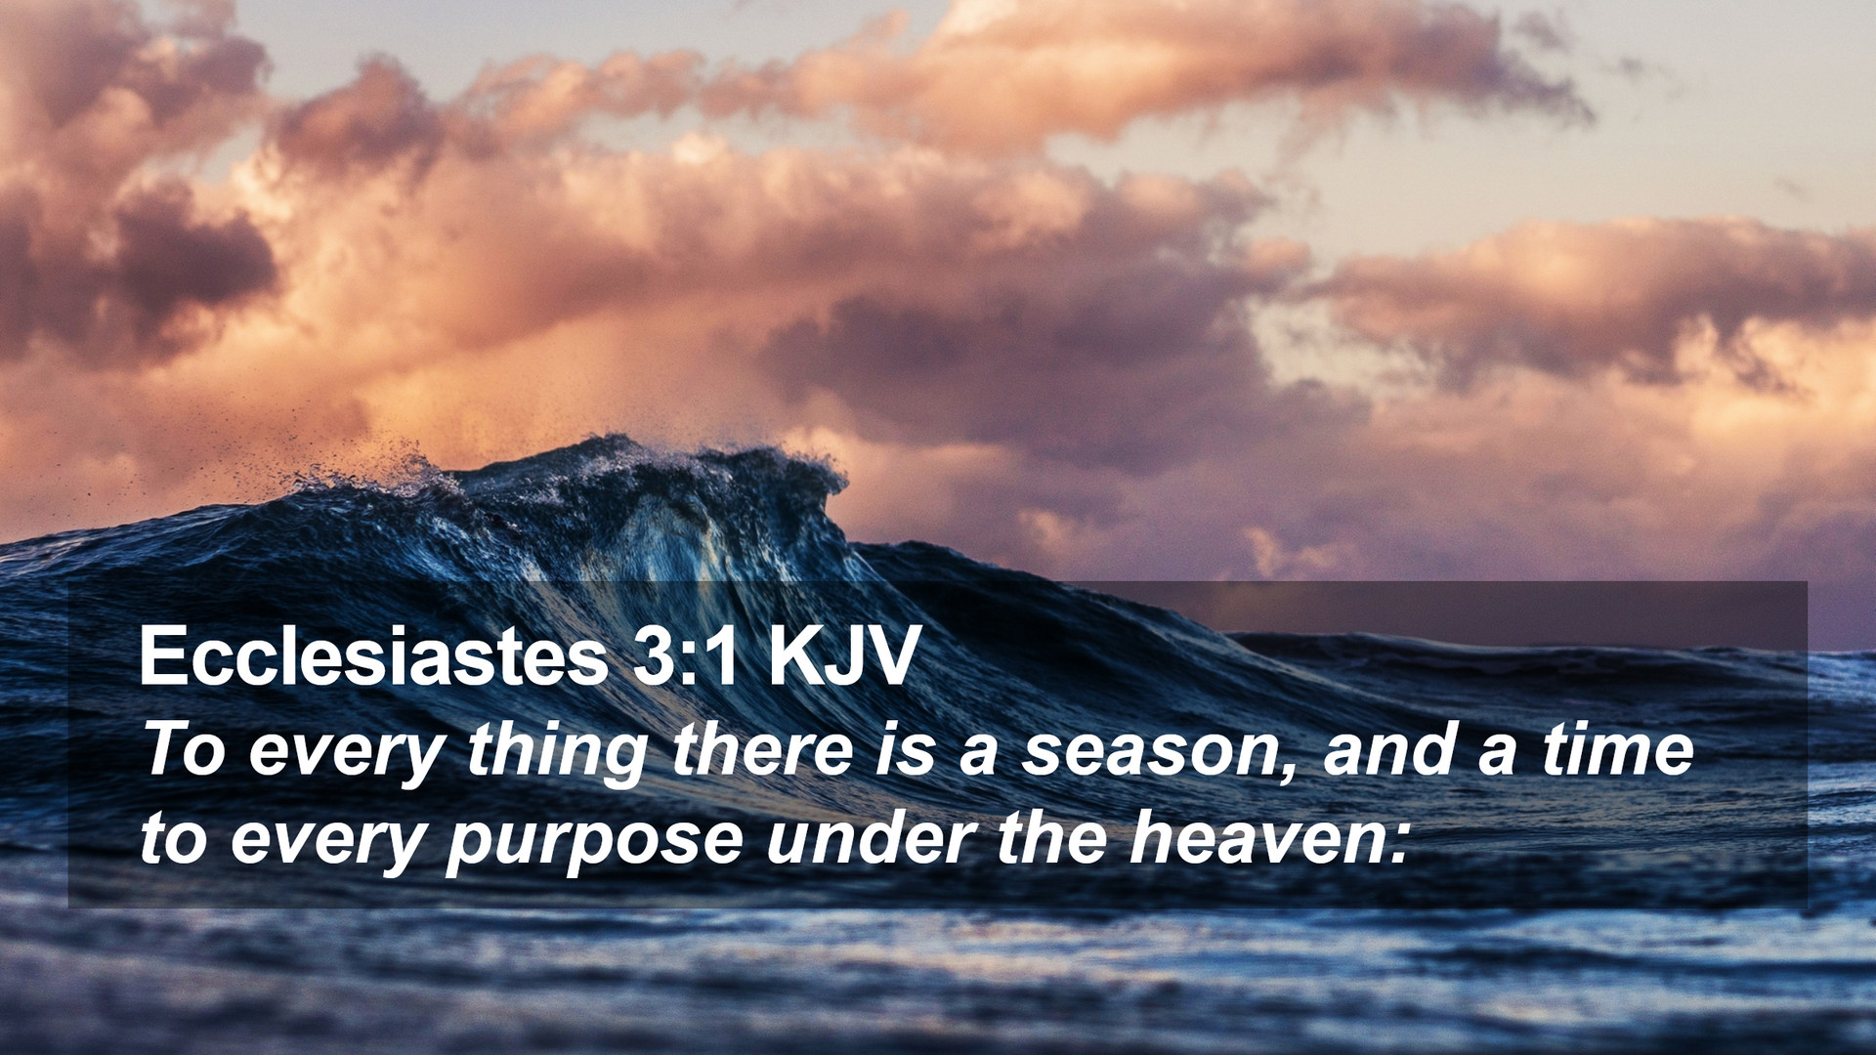

Slide 32
What is important to you?
There is an appropriate time for everything
There is an appropriate amount of time for everything
There is an appropriate amount of focus for everything
There are ways to complete tasks more efficiently
Improve your tools
Improve your personal capabilities
Improve your work situation

Slide 33
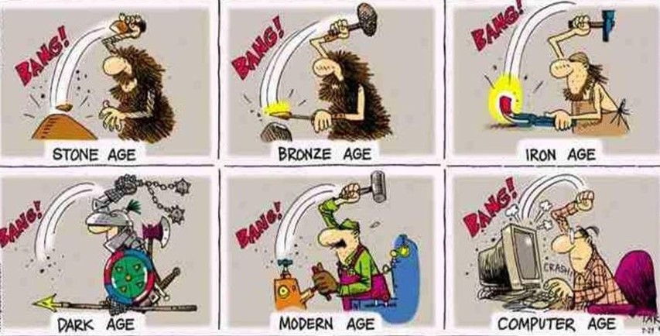
Efficiency

Slide 34
Efficiency
Take breaks
Focus time
Done is better than perfect
Schedule your phone and email time
Value each minute
Increase your weak point
No!
Set deadlines
Rest and relaxation
Notes:
https://www.alpinesbsolutions.com/9-ways-increase-efficiency-work-biz/
Increase your weak point - We all have a time of the day that is the slump. Know where your weak point is and plan for it. If you are an afternoon slump person, know it and own it! Prepare for it by having that cup of coffee, or schedule your passion project during that time. If you aren’t prepping and working on something you don’t want to do at that time, you will not work

Slide 35
Personal capability – dealing with stress
In the long-term
Exercise regularly
Eat well
Focus your mind
Relax
In the short-term
Take a walk
Take a break
Get a hug
Home
Express yourself
Take action
Get organised
Create your own space
Work
Understand the expectations
Avoid multitasking
Minimise conflict
Get comfortable
Relationships
Remove external stressors
Get to the root of the problem
Save time for yourself
Improve your communication skills

Slide 36
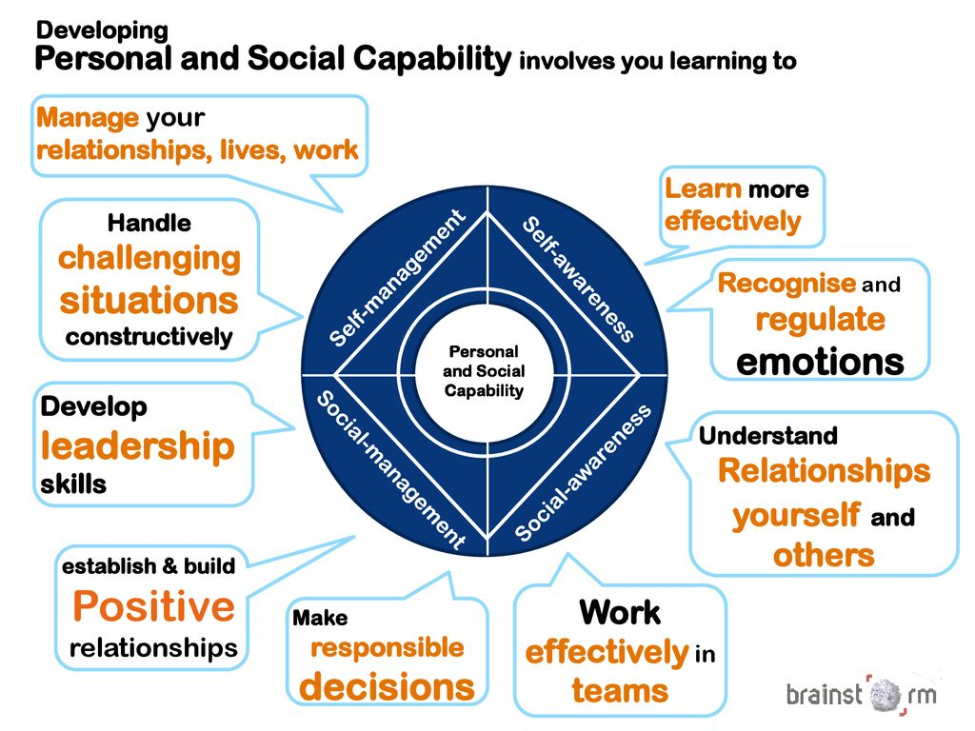
Capability

Slide 37

OBSTACLES

Slide 38
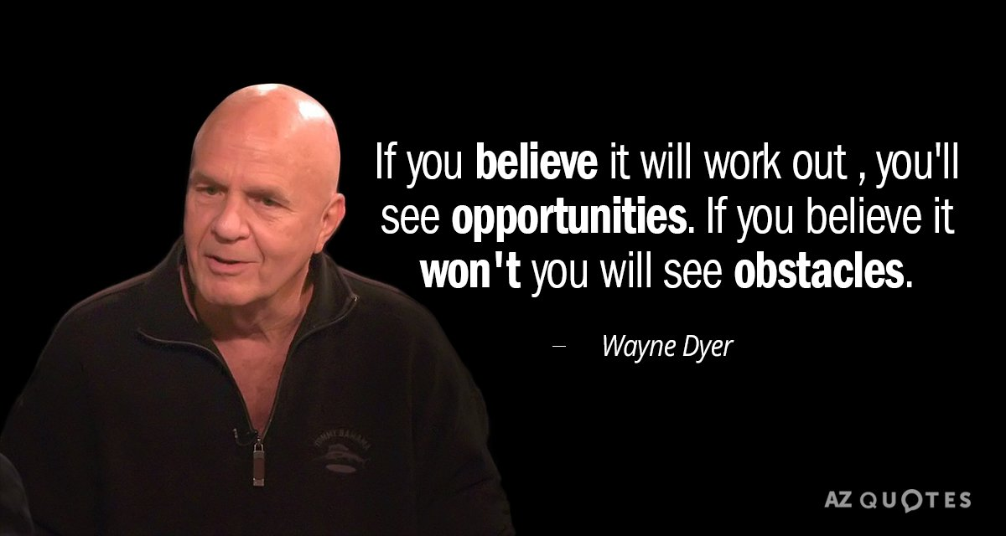

Slide 39

Obstacles for work life balance
Lack of
motivation
determination
goals and vision
time and focus
Too many
distractions
tasks
projects
worries
Notes:
Projects include personal projects that never gets finished
Spend time detailing how to overcome each of the obstacles
motivation – what are you trying to achieve? Why? Maslow’s hierchy of needs. Intrinsic motivators
determination – Imagine, dream and believe in yourself. With determination and belief, you will be surprised at what you can accomplish
goals and vision – assign reachable goals, adjust. Plan your path for success
time and focus – compromise, prioritise, allocate focused time, give yourself breaks, etc.
distractions – learn to say no, learn to schedule and plan things, learn to disconnect
tasks – plan, schedule, prioritise, delegate, ignore
projects – personal projects are great, but too many of them becomes stressful. Focus on what is achievable
worries – do they really help? What do they actually change?

Slide 40
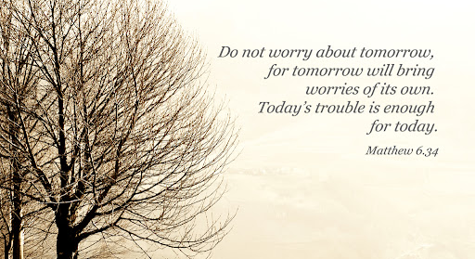

Slide 41
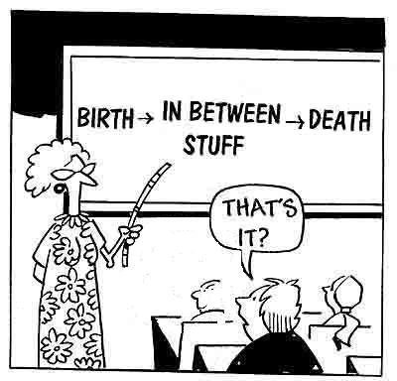

What is it all about?
Joy
Family
Fulfillment
Legacy
Is work important?
Your equation?

Slide 42
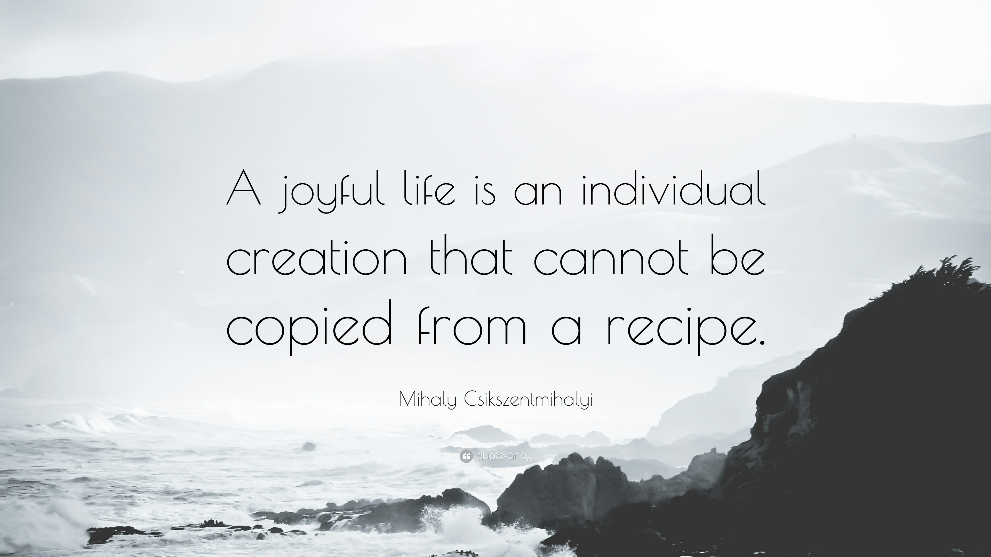
Notes:
Mihaly Csikszentmihalyi is a Hungarian-American psychologist. He recognised and named the psychological concept of flow, a highly focused mental state conducive to productivity.

Slide 43
Questions?
Josef Hallberg
Phone: +46 920 49 31 77
Mail: josef.hallberg@ltu.se

